Slide 1

ESP8266 wi-fi Repeater(IOT)

Slide 2
Team Members
Name | DEPT | College | E-mail | phone
1. Halish richard J | CSE- 2year | Parisutham Institute of Technology and Science | halishrichard5@gmail.com | 9790450229
2.Govardhanan A | CSE- 3year | Parisutham Institute of Technology and Science | govardhan.sayanan@gmail.com | 9363505985
3.Ershad ahamed U | CSE-2year | Parisutham Institute of Technology and Science | ershadahamed2@gmail.com | 7397017799

Slide 3
ABSTRACT
A wireless repeater is a device that takes an existing signal from a wireless router or wireless access point and rebroadcasts it to create a second network.
When two or more hosts have to be connected with one another over the IEEE 802.11 protocol and the distance is too long for a direct connection to be established, a wireless repeater is used to bridge the gap.
It can be a specialized stand-alone computer networking device. Also, some wireless network interface controllers (WNIC)s optionally support operating in such a mode.
Those outside of the primary network will be able to connect through the new "repeated" network.
However, as far as the original router or access point is concerned, only the repeater MAC is connected, making it necessary to enable safety features on the wireless repeater.
Wireless repeaters are commonly used to improve signal range and strength within homes and small offices.

Slide 4
EXISTING METHOD
ESP8266 based Wi-Fi access point using MicroPython By Nikhil Agnihotri
Many IoT applications are controlled with the help of a webpage or an HTML website running within a Local Area Network (LAN) or Wireless Local Area Network (WLAN).
Some examples of such IoT applications include home automation, office automation, and smart farming. The HTML webpage or website controlling the things is hosted on a microcomputer or microcontroller.
The Wi-Fi development boards like ESP8266 provide a Wi-Fi networking interface where the board can act as both a Wi-Fi station or Wi-Fi access point.
Check out how to connect ESP8266 to a WiFi connection using MicroPython network module.
Whether configured as a Wi-Fi station or Wi-Fi access point, MicroPython ports, including ESP8266 and ESP32 can host HTML webpages using the MicroPython socket module. You can check out how to configure ESP8266 or other

Slide 5
PROPOSED METHOD
We have successfully increase wi-fi range
This device is flexible and can easily access by the everybody.

Slide 6
SOFTWARE REQUIREMENTS
Visual code editor
Pymakr(vs code extension)
CP210x Windows Drivers
HARDWARE REQUIREMENTS
ESP8266

Slide 7
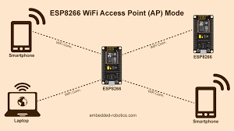
System architecture

Slide 8
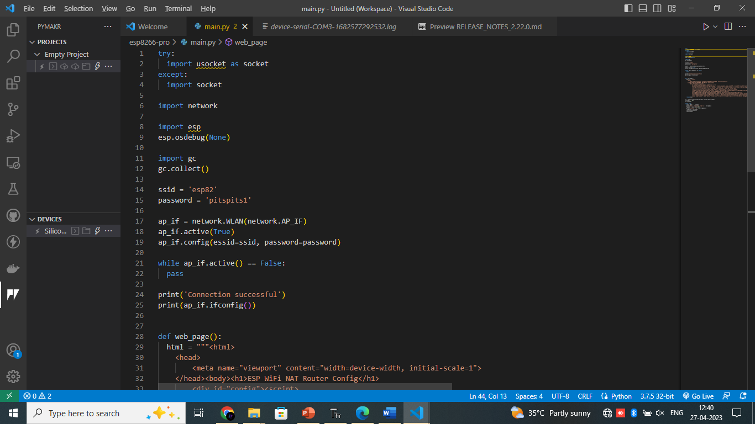
SYSTEM TESTING

Slide 9
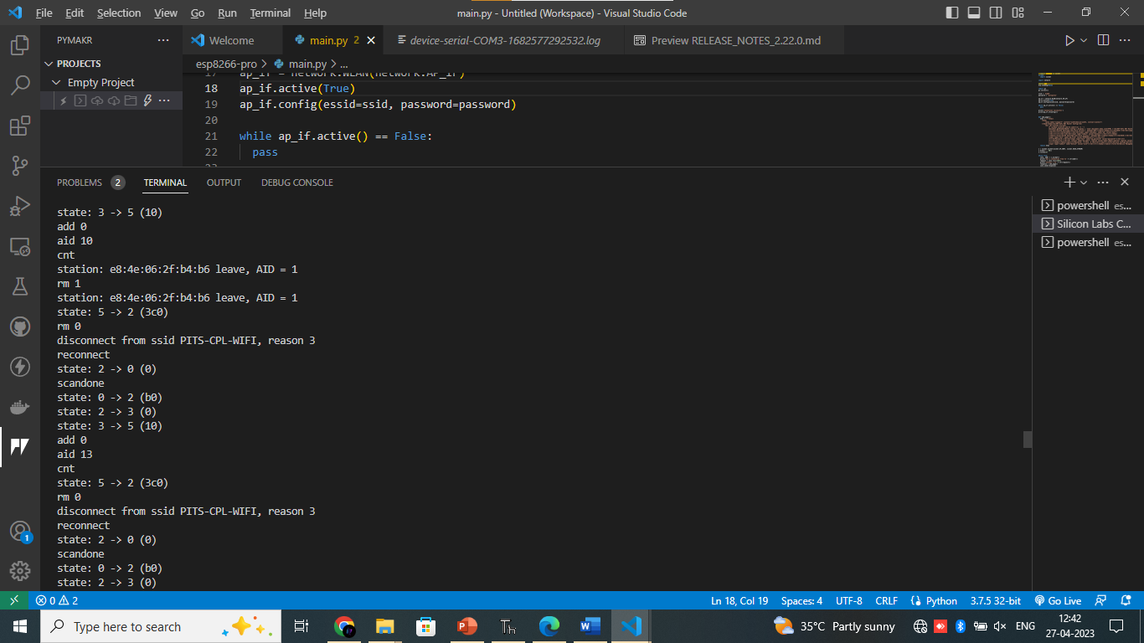
VALIDATION

Slide 10
FUTURE ENHANCEMENTS
CONCLUSION
After the result wi-fi range will be increase
With the help of this project the wi-fi range will cover more area
This project is developed for External low cost wi-fi repeater.

Slide 11
APPLICATIONS
Institution
Hospital
Railway station
Malls

Slide 12
THANK YOU

